Slide 1
Benchmarking Hybrid Graph Transactional/Analytical Processing and Elastic Scale-Out in Open-Source Distributed Graph Databases
MUSTAFA CAN ÇALIŞKAN, 504251544
BLG 564E – Advanced Database Systems
Related Work Review and Project Plan

Slide 2
PRESENTATION ROADMAP
Part 1 — Background and motivation
Why graph databases and hybrid workload matters
Part 2 — Review of 6 recent papers
Part 3 — How to write a benchmarking paper
Part 4 — My planned paper

Slide 3
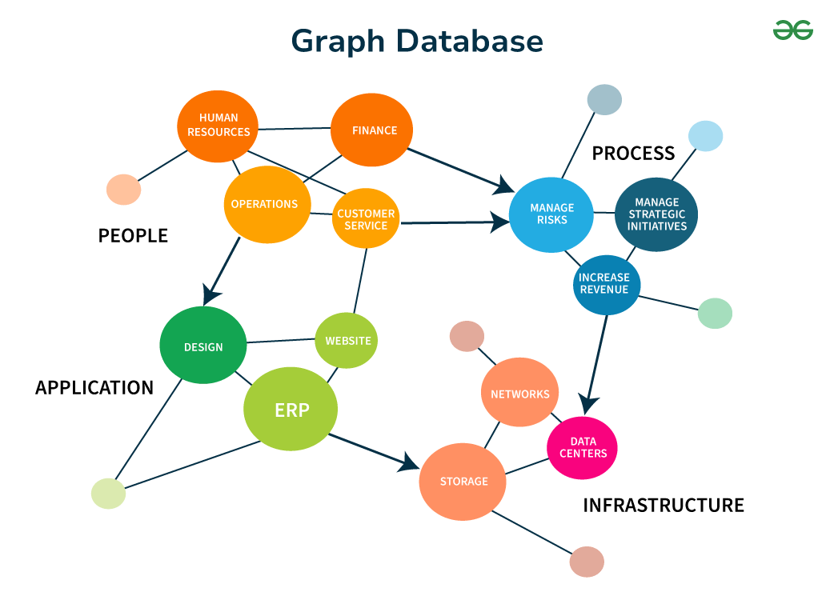
BACKGROUND AND MOTIVATION
Graph databases keep data as nodes and edges
They are very useful for connected data
For example: social networks, fraud connections, recommendation systems
In real systems, we usually need two things together
transactions and analytics
Sometimes systems also need elastic scale-out
This means we can add new machines while system is still running
There are already many strong studies in this area
But still these studies are a bit separated from each other
So my project asks this question:
How do open source distributed graph databases behave under mixed workloads and scale-out?
Graph database illustration: https://www.geeksforgeeks.org/dbms/neo4j-introduction/

Slide 4
HOW I ORGANIZED THE RELATED WORK
Benchmark papers
SNB BI — graph OLAP
FinBench — graph OLTP in finance
SNB Interactive v2 — transactional benchmark design
System papers
Galaxybase — graph HTAP
G-Tran — distributed graph transactions
BACH — storage design for mixed workloads
Common gap: no portable, open, multisystem benchmark for mixed workloads under a controlled scale-out event

Slide 5
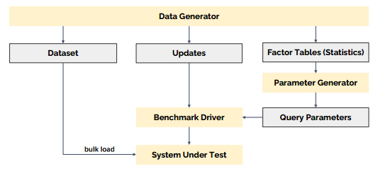
PAPER 1: FINBENCH
Paper: The LDBC Financial Benchmark: Transaction Workload
Venue / Year: PVLDB, 2025
Authors: Shipeng Qi et al.
Institutions: Ant Group, Tsinghua University, Peking University, HKUST(GZ), LDBC, and others
Main findings:
Problem: older graph benchmarks do not cover financial graphs very well
Method: it builds an LDBC-style benchmark with scalable data generator, parameter tuning, update stream and time-based driver
Key results: it shows new bottlenecks in time-window queries, recursive path filtering, and read-write transactions
Strength: it takes graph benchmarking beyond only social-network cases
Weakness: it is still mainly a transaction benchmark
My difference: I will take this transaction idea and combine it with analytics and scale-out
Diagram source: The LDBC Financial Benchmark: Transaction Workload

Slide 6
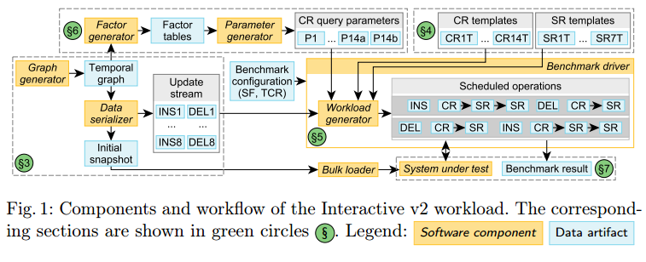
PAPER 2: SNB INTERACTIVE V2
Paper: The LDBC Social Network Benchmark Interactive Workload v2
Year: 2023
Authors: Dávid Puroja, Gábor Szárnyas, Jack Waudby, Peter Boncz, and others
Institutions: CWI, Newcastle University, LDBC and collaborators
Main findings:
Problem: older transaction benchmarks for graphs needed better delete support, scaling and more clear rules
Method: it builds a stronger benchmark design with parameter tuning, scheduling, latency tracking, and auditing
Key results: it brings deep delete operations, 95% on-time rule and ACID checks
Strength: its benchmark method is very strong
Weakness: it still focuses only on transaction side
My difference: I will take these transaction patterns but combine them with analytics and scale-out
Diagram source: The LDBC Social Network Benchmark Interactive Workload v2

Slide 7
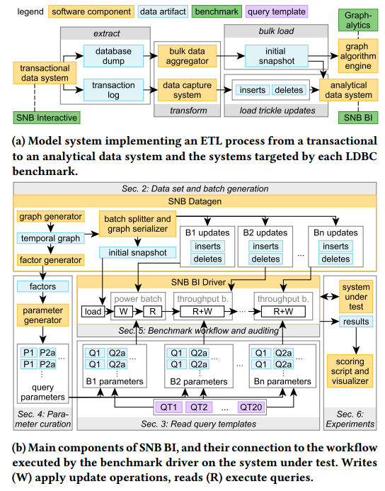
PAPER 3: SNB BI
Paper: The LDBC Social Network Benchmark: Business Intelligence Workload
Year: 2022
Authors: Gábor Szárnyas, Jack Waudby, Benjamin A. Steer, Dávid Szakállas, Altan Birler, Mingxi Wu, Yuchen Zhang, Peter Boncz
Institutions: CWI, Newcastle University, Pometry, TUM, TigerGraph, and collaborators
Main findings:
Problem: graph systems needed a realistic and portable OLAP benchmark
Method: it builds the benchmark with choke-point design, scalable data generation, updates, and parameter tuning
Key results: it gives strong portability and clear power and throughput metrics
Strength: very strong benchmark method
Weakness: not a full mixed OLTP+OLAP benchmark
My difference: I will take its analytics side, but use a more portable subset and add scale-out
Diagram source: The LDBC Social Network Benchmark: Business Intelligence Workload

Slide 8
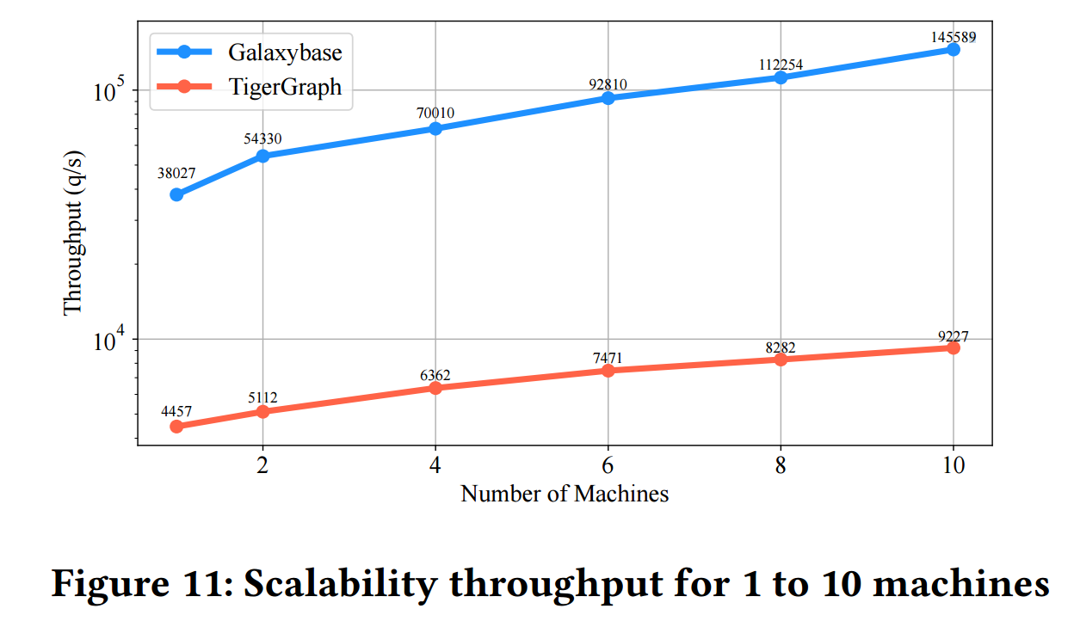
PAPER 4: GALAXYBASE
Paper: Galaxybase: A High Performance Native Distributed Graph Database for HTAP
Venue / Year: PVLDB, 2024
Authors: Bing Tong et al.
Institutions: CreateLink and HKUST(GZ)
Main findings:
Problem: how to support mixed workloads in one distributed graph system
Method: native graph storage, separate modules and graph-aware transaction design
Key results: strong throughput and good scale-out results
Strength: shows clearly why mixed workloads matter
Weakness: not a portable benchmark paper
My difference: I will compare multiple open source systems with one common benchmark setup
Diagram source: Galaxybase: A High Performance Native Distributed Graph Database for HTAP

Slide 9
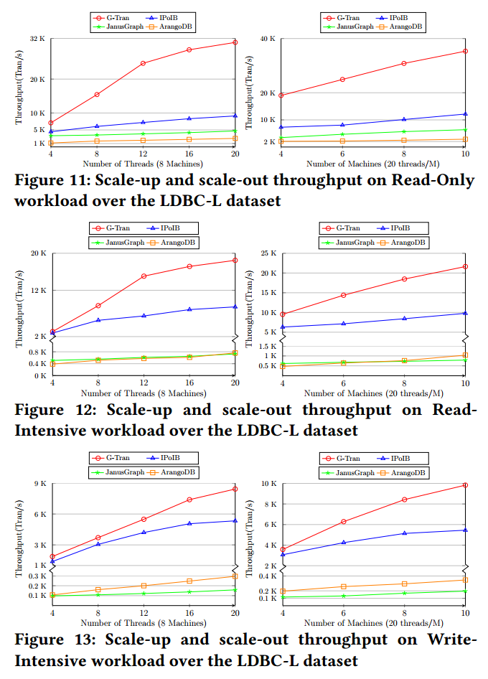
PAPER 5: G-TRAN
Paper: G-Tran: Efficient Distributed Graph Transactions
Venue / Year: EuroSys, 2024
Authors: Zhaoyang Wang et al.
Institutions: National University of Singapore and collaborators
Main findings:
Problem: distributed graph transactions are hard because graph access is irregular and cross partition work is costly
Method: specialized transaction design for distributed graph workloads
Key results: better performance than strong baselines, with good scale-up and scale-out
Strength: strong focus on transaction efficiency
Weakness: not focused on mixed workloads or portable benchmarking
My difference: I will study mixed workloads, not only transaction efficiency
Diagram source: G-Tran: Efficient Distributed Graph Transactions

Slide 10
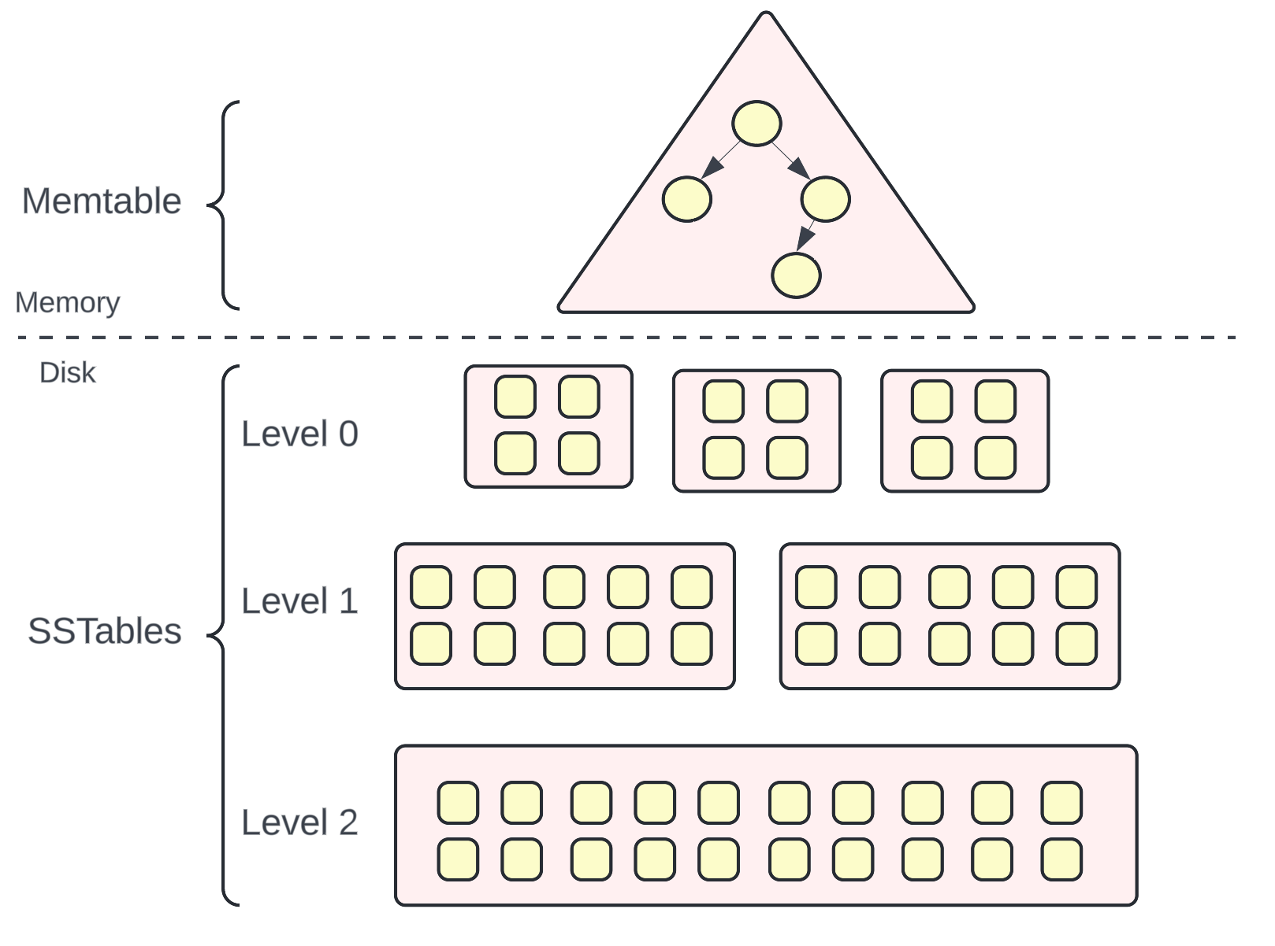
PAPER 6: BACH
Paper: BACH: Bridging Adjacency List and CSR Format using LSM-Trees for HGTAP Workloads
Venue / Year: PVLDB, 2025
Authors: Jianfeng Huang, Yihao Cao, Shubing Ren, Baohua Wu, Dongjing Miao
Institutions: Harbin Institute of Technology, Central South University
Main findings:
Problem: one storage layout cannot fit all graph workloads
Method: it combines two storage styles in one design
Key results: strong results in interactive, BI and mixed tests
Strength: shows why storage layout matters in mixed workloads
Weakness: not a portable benchmark method
My difference: I will measure similar tradeoffs across multiple open source systems
Diagram source: https://vivekbansal.substack.com/p/what-is-lsm-tree

Slide 11
WHAT MAKES A GOOD BENCHMARKING PAPER?
Clear scope and research gap from the start
Separate section for benchmark design
Separate and clear experimental setup
Clear metrics and fair comparison rules
Results in logical order
Open discussion of limitations

Slide 12
HOW SHOULD EXPERIMENTS BE DESIGNED?
Systems should be compared on a common subset
Transaction, analytics, and mixed workloads should be separated
Hardware, configuration and tuning should be reported clearly
Metrics should be fair for all systems
Experiments should come in clear order
baseline → mixed workload → scale-out

Slide 13
HOW SHOULD RESULTS BE PRESENTED?
Each figure should answer one clear question
Use clear figures to show how benchmark works
Use result figures to show one performance point each time
Do not use too many disconnected charts
Try to build a story, not only show results

Slide 14
MY PLANNED PAPER
Paper type: benchmarking paper
Goal: show how selected open source distributed graph databases behave when mixed workloads applied and scale-out
Workload: transaction, analytics and mixed execution
Target systems: open source distributed property graph systems
Evaluation: throughput, latency, interference and scale-out
Main question: which system choices work well under mixed workloads and which ones struggle?

Slide 15
EXPECTED CONTRIBUTON
More portable mixed workload benchmark
Focus on open source distributed graph systems
Clearer view of performance tradeoffs
Controlled study of elastic scale-out
Practical benchmark for future graph database research

